Slide 1
Relational Algebra

Slide 2
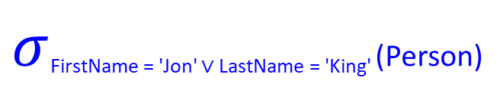
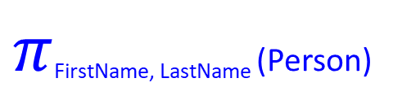
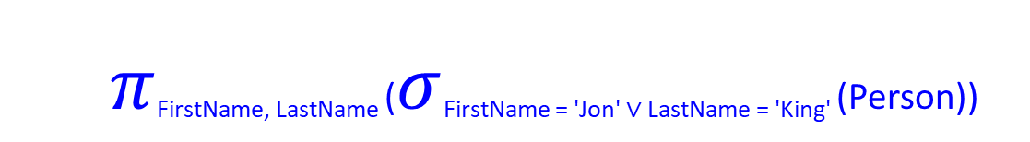
Projection and Selection
Person
FirstName | LastName | Phone | Email
Jon | Snow | 0551-999-210 | knowsnothing@hotmail.com
Daenerys | Targaryen | 0569-988-112 | bendtheknee@gmail.com
Jamie | Lannister | 0531-987-654 | handsfree@gmail.com
Night | King | 0566-123-456 | killerstare@gmail.com
$π$_{FirstName, LastName} (Person)
$σ$FirstName = 'Jon' ∨ LastName = 'King' (Person)
FirstName | LastName
Jon | Snow
Daenerys | Targaryen
Jamie | Lannister
Night | King
FirstName | LastName | Phone | Email
Jon | Snow | 0551-999-210 | knowsnothing@hotmail.com
Night | King | 0566-123-456 | killerstare@gmail.com
$π$_{FirstName, LastName} ($σ$FirstName = 'Jon' ∨ LastName = 'King' (Person))
FirstName | LastName
Jon | Snow
Night | King

Slide 3
Union, Difference and Intersection
GoodGuys
BadGuys
RandomCombo1
RandomCombo2
FirstName | LastName
Jon | Snow
Daenerys | Targaryen
FirstName | LastName
Cersei | Lannister
Night | King
FirstName | LastName
Jon | Snow
Daenerys | Targaryen
Jamie | Lannister
Night | King
FirstName | LastName
Night | King
Arya | Stark
Cersei | Lannister
Daenerys | Targaryen
GoodGuys ∪ BadGuys
RandomCombo1 – RandomCombo2
FirstName | LastName
Jon | Snow
Daenerys | Targaryen
Cersei | Lannister
Night | King
FirstName | LastName
Jon | Snow
Jamie | Lannister
RandomCombo1 ∩ RandomCombo2
FirstName | LastName
Daenerys | Targaryen
Night | King
Amazingly,
R∩S = R − (R − S)

Slide 4

Cross Product
Person
Weapon
FirstName | LastName | Email
Jon | Snow | knowsnothing@hotmail.com
Night | King | killerstare@gmail.com
Weapon | Metal
Sword | Valyrian steel
Dagger | Dragon glass
Person $×$ Weapon
FirstName | LastName | Email | Weapon | Metal
Jon | Snow | knowsnothing@hotmail.com | Sword | Valyrian steel
Jon | Snow | knowsnothing@hotmail.com | Dagger | Dragon glass
Night | King | killerstare@gmail.com | Sword | Valyrian steel
Night | King | killerstare@gmail.com | Dagger | Dragon glass

Slide 5

Natural Join
Person
WeaponOwner
FirstName | LastName | Email
Jon | Snow | knowsnothing@hotmail.com
Daenerys | Targaryen | bendtheknee@gmail.com
Tyrion | Lannister | idrinkandiknow@gmail.com
Night | King | killerstare@gmail.com
Weapon | LastName | Metal
Sword | Snow | Valyrian steel
Dagger | Lannister | Dragon glass
Compute R⨯S
Select rows where attributes that appear in both relations have equal values
Project all unique attributes and one copy of each of the common ones
Person $×$ WeaponOwner
FirstName | LastName | Email | Weapon | LastName | Metal
Jon | Snow | knowsnothing@hotmail.com | Sword | Snow | Valyrian steel
Jon | Snow | knowsnothing@hotmail.com | Dagger | Lannister | Dragon glass
Daenerys | Targaryen | bendtheknee@gmail.com | Sword | Snow | Valyrian steel
Daenerys | Targaryen | bendtheknee@gmail.com | Dagger | Lannister | Dragon glass
Tyrion | Lannister | idrinkandiknow@gmail.com | Sword | Snow | Valyrian steel
Tyrion | Lannister | idrinkandiknow@gmail.com | Dagger | Lannister | Dragon glass
Night | King | killerstare@gmail.com | Sword | Snow | Valyrian steel
Night | King | killerstare@gmail.com | Dagger | Lannister | Dragon glass
Person ⋈ WeaponOwner
FirstName | LastName | Email | Weapon | Metal
Jon | Snow | knowsnothing@hotmail.com | Sword | Valyrian steel
Tyrion | Lannister | idrinkandiknow@gmail.com | Dagger | Dragon glass

Slide 6

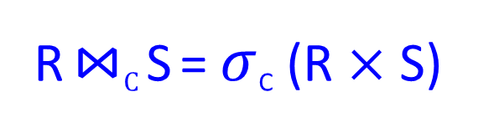
Condition Join (Theta/Inner Join)
Person
WeaponOwner
FirstName | LastName | Email
Jon | Snow | knowsnothing@hotmail.com
Daenerys | Targaryen | bendtheknee@gmail.com
Tyrion | Lannister | idrinkandiknow@gmail.com
Night | King | killerstare@gmail.com
Weapon | Name | Metal
Sword | Snow | Valyrian steel
Dagger | Lannister | Dragon glass
Person $×$ WeaponOwner
R ⋈_{C} S = $σ$_{C} (R $×$ S)
FirstName | LastName | Email | Weapon | Name | Metal
Jon | Snow | knowsnothing@hotmail.com | Sword | Snow | Valyrian steel
Jon | Snow | knowsnothing@hotmail.com | Dagger | Lannister | Dragon glass
Daenerys | Targaryen | bendtheknee@gmail.com | Sword | Snow | Valyrian steel
Daenerys | Targaryen | bendtheknee@gmail.com | Dagger | Lannister | Dragon glass
Tyrion | Lannister | idrinkandiknow@gmail.com | Sword | Snow | Valyrian steel
Tyrion | Lannister | idrinkandiknow@gmail.com | Dagger | Lannister | Dragon glass
Night | King | killerstare@gmail.com | Sword | Snow | Valyrian steel
Night | King | killerstare@gmail.com | Dagger | Lannister | Dragon glass
Person ⋈_{LastName = Name} WeaponOwner
FirstName | LastName | Email | Weapon | Name | Metal
Jon | Snow | knowsnothing@hotmail.com | Sword | Snow | Valyrian steel
Tyrion | Lannister | idrinkandiknow@gmail.com | Dagger | Lannister | Dragon glass

Slide 7
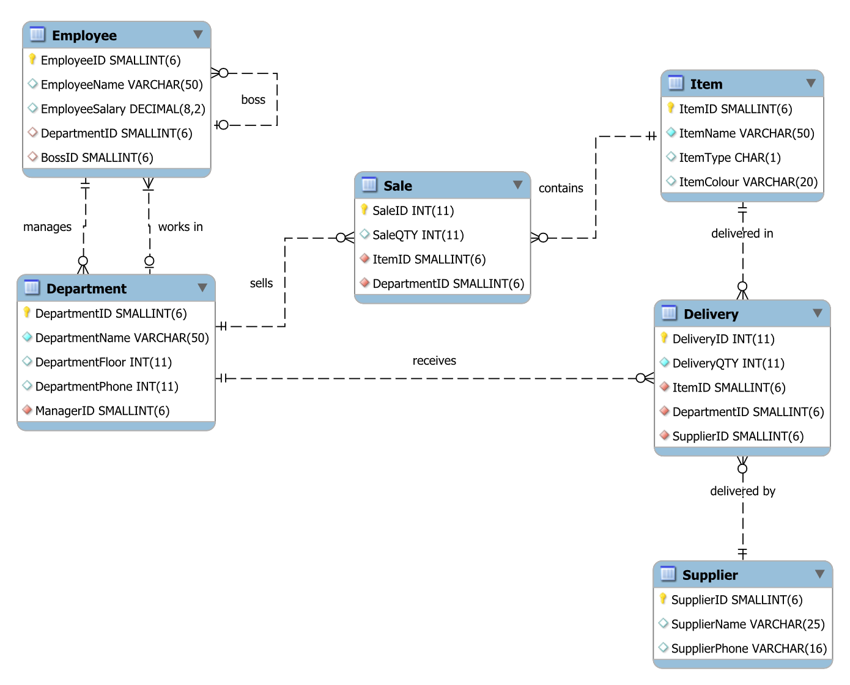

Slide 8


Find the names of all employees
Find the names of all employees in department number 1
$π$_{EmployeeName} ($σ$_{DepartmentID = 1} (Employee))
$π$_{EmployeeName} (Employee)

Slide 9

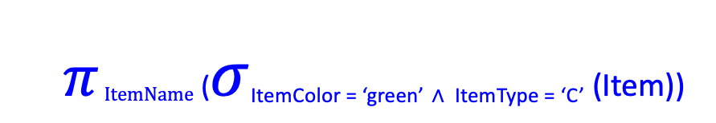
List the names of green items of type C
Find the items sold by the department located on the second floor (only show ItemID)
$π ItemName$ ($σ$_{ItemColor = ‘green’} _{∧ ItemType = ‘C’} (Item))
$π ItemID$ ($σ$_{DepartmentFloor = 2} (Department) ⋈ Sales)
_{∨ = OR}
_{∧ = AND}

Slide 10
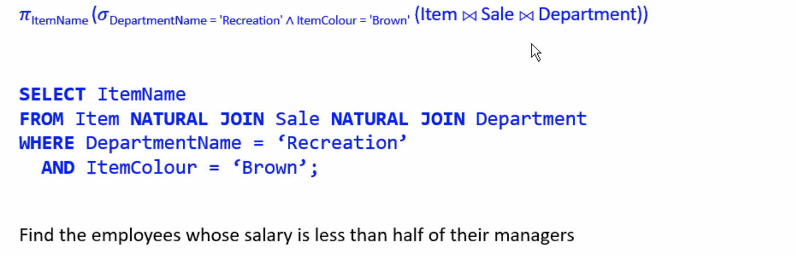
Find the names of brown items sold by the Recreation department
$π ItemName$ ($σ$_{ItemColor = ‘Brown’} (Item)) ⋈ Sales ⋈ ($σ$_{DepartmentName = ‘Recreation’} (Department))

Slide 11
